Slide 1
Speech Emotion Recognition (SER)
Presented
By
Parth Ahuja(1811981220)
Atishaya Jain(1811981080)
Deepak(1811981097)
Under the supervision
Of
(Dr. Ashutosh Kumar Dubey and Ms. Ravita Chahar )
Department of Computer Science and Engineering

Slide 2


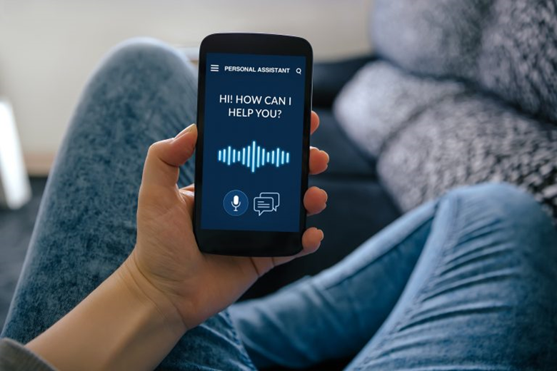

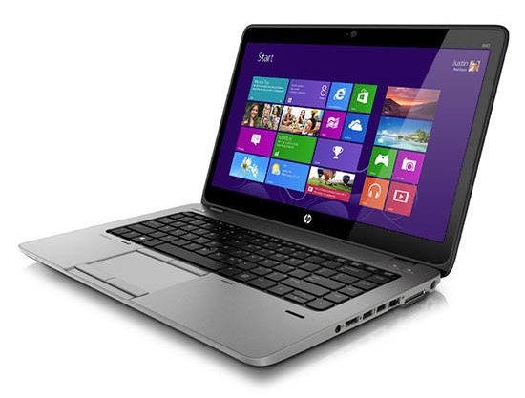
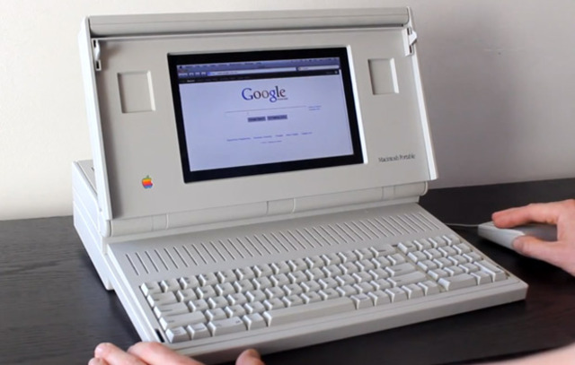
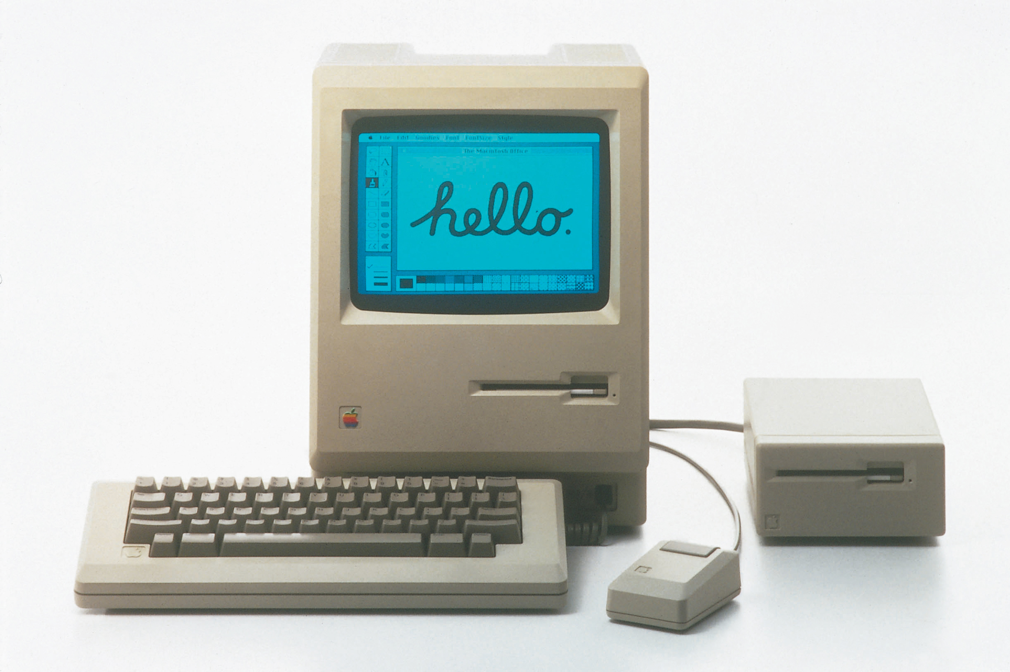
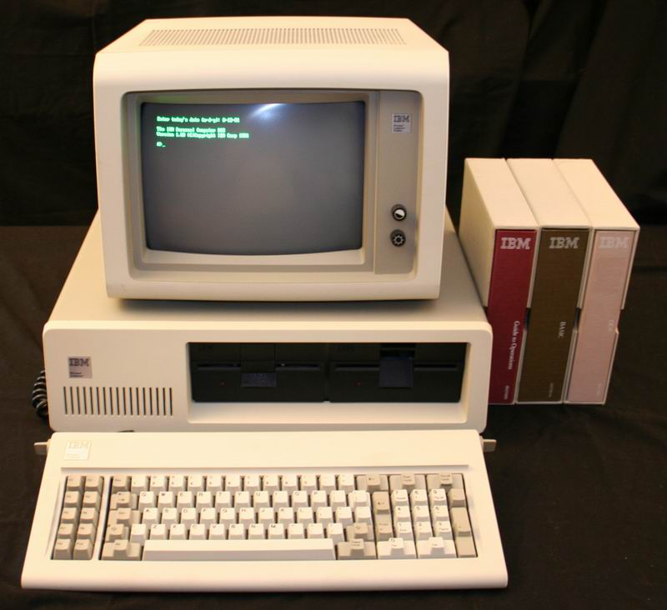
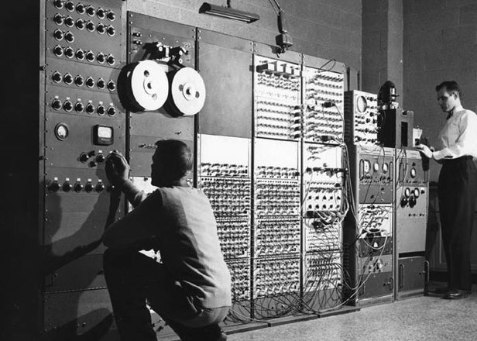
Human Machine Interaction (HMI) Journey …

Slide 3
What’s The Future ???

Slide 4
Problem?
Non Intuitive Behavior
Inadequacy
In
Cyber Security
Emotions Are Subjective
Human Machine Interaction

Slide 5
Objective & Solution ?
Voice
A.I.
Emotion Recognition
What is Speech Emotion Recognition?
SER is the act of attempting to recognize human emotion and affective states from speech.
Capitalizing on the fact that voice often reflects underlying Emotion through Tone and Pitch.
What is our Objective?
To develop a Machine Learning Project that can recognize human emotions through Speech.

Slide 6
How Does it Work ???
Signal Acquisition
Feature Extraction
Emotion
Recognition
Voice
Digital Signal | Feature
Result
Model of Emotion Description
Corpus

Slide 7
Voice Interaction (HMI) Trend
Natural Human-Machine Interface is shaping our life –
Human Machine Interface (HMI) began as Computer Interface because early computers were not interactive.
Natural User Interface i.e. NUI is the second revolution of HMI.
Touch, Voice, Visual Modalities etc. compared with keyboard and mouse are considered as a Natural Interaction

Slide 8
Real Life Applicability
Enhance
User
Interface
Emotionally Intelligent Robotics
Cyber
Security
Improve
Online
Learning

Slide 9
Dataset … (URL Sources)
Ryerson Audio-Visual Database of Emotional Speech and Song Dataset
URL -https://drive.google.com/file/d/1wWsrN2Ep7x6lWqOXfr4rpKGYrJhWc8z7/view
RML Emotional Database
URL –
http://www.rml.ryerson.ca/rml-emotion-database.html
Berlin Database of Emotional Speech
URL –
http://pascal.kgw.tu-berlin.de/emodb/index-1280.html

Slide 10

Tools/Methods …?
Librosa Library will be used for analysing audio.
For using Dataset in proper way, Multi-Layer Perceptron (MLP) Classifier will be used.
MLP will be used for importing the Dataset.
Confusion Matrix will be used for evaluating the performance of the model.

Slide 11

Implementation & Specification …
Planning, Analysis & Design of the project is nearly ready.
We are working on future complete Implementation and Testing of the project
Specification Requirements -
Python with Installed Packages – SpeechRecognition, wheel, PyAudio etc.

Slide 12

Result …?
Overview of Implementation of Speech Recognition.
Searching & Viewing of the found result.
Implementation of Python Audio Packages.
Working Speech Recognition from Audio to Text.

Slide 13


